Slide 1

Bright TV
Viewership Performance & Demographic Analysis
Data-Driven Insights for Content Strategy
Created by: Belinda Madzhie

Slide 2
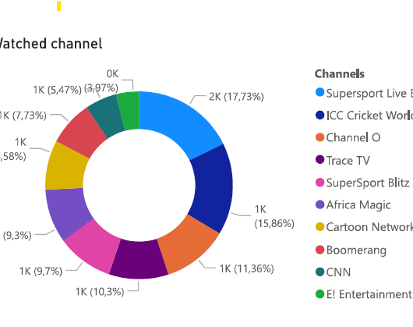
Top Channels Performance
Sports is a winner

Slide 3
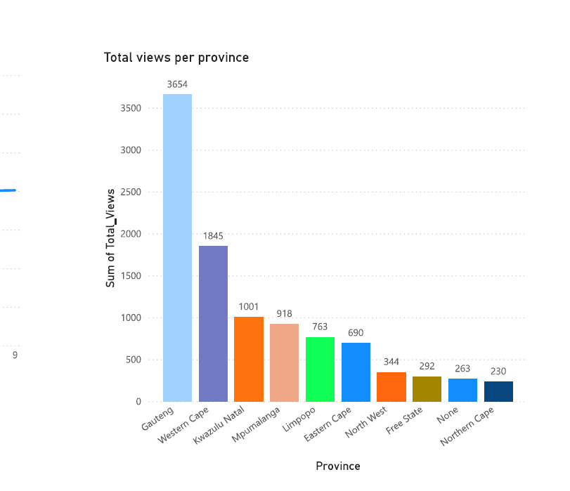
Geographic Distribution (Province Views)
Gauteng is the primary driver of viewership with 3,654 views, nearly double the next highest province
Western Cape (1,845) and Kwazulu Natal (1,001) follow as significant markets.
Lower engagement is seen in the Northern Cape (230) and Free State (292).

Slide 4
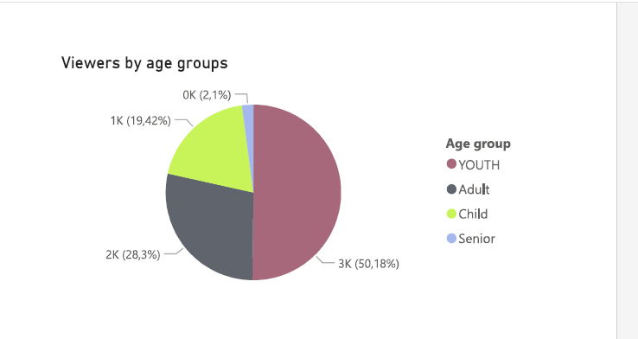
Audience Demographics (Age & Race)
Age: The audience is heavily skewed toward YOUTH (2,697 views), followed by Adults
Seniors represent the smallest segment (113).
Race: The highest viewership comes from the "black" demographic category (4,331), significantly outpacing other segments.

Slide 5
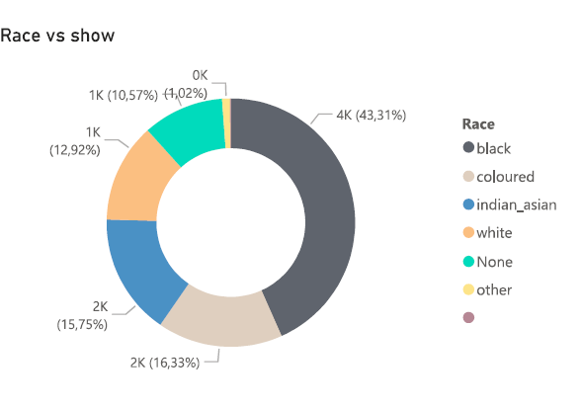
Audience Composition by Race
Market Alignment: Highlight that the content is resonating most strongly with the Black demographic. This is a key insight for advertisers or sponsors looking to reach this specific market.
Relative Balance: Note that the Coloured, Indian/Asian, and White segments are relatively balanced (ranging between 12%–16%), showing the content has a broad, multi-cultural appeal.
Actionable Insight: If the goal is growth, you might discuss whether to lean further into the majority audience's preferences or create targeted campaigns to increase the share of the 12%–16% segments..

Slide 6
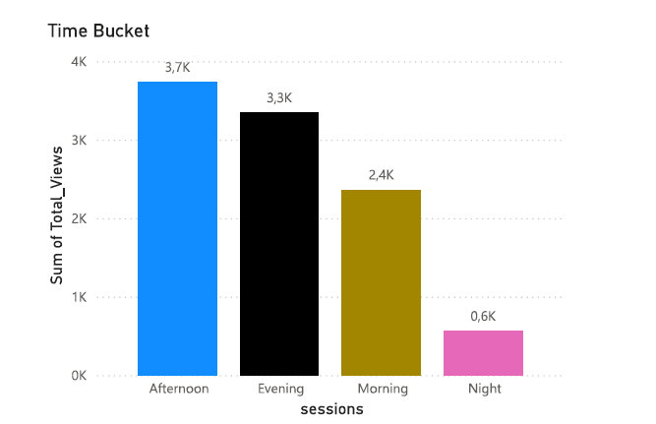
Viewership Trends by Time of Day
Line Graph showing "Hourly Views" (0-23).
Peak Viewing: Usage climbs steadily from 07:00 and plateaus between 12:00 and 20:00, with the absolute peak occurring at 17:00 (648 views)
The "Dead Zone": Consumption is lowest between 02:00 and 05:00 AM (hitting a low of 49 views at 04:00).
Prime Buckets: Afternoon is the most active time bucket (3,734 views), followed by Evening.

Slide 7
Strategic Recommendations
Content
Prioritize sports and youth-oriented music programming
Growth Opportunity
Develop content to capture the under-represented "Senior" age group and "Morning" time slots.
Scheduling
Focus major premieres or high-value ads during the "Afternoon" bucket (12:00–17:00).
Regional Focus: Increase localized marketing efforts in Gauteng and Western Cape to maintain the stronghold.

Slide 8

Q&AText: Thank you! Any questions?
Belinda Madzhie
madzhielinda@gmail.com

